Slide 1

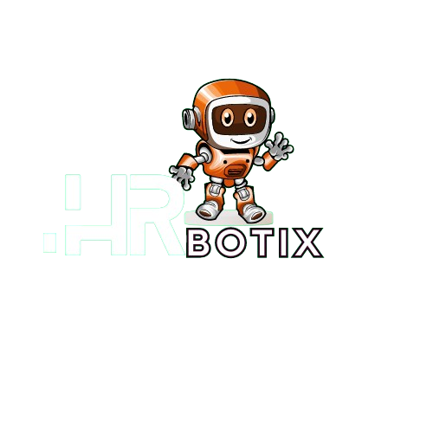
Project Title
and supervisor's names
HRBotix System
AI-EHRM System
Dr. Mohammed Attia
Eng. Mohammed Hussein

Slide 2















TEAM MEMBERS
9
KEROLOS M.
1
12
10
MOHAMED S.
2
SAYED M.
12
HOSSAM S.
9
4
AMIR S.
4
ROBERT K.
10
2
5
KEROLOS M.
5
1

Slide 3


Agenda
1
Introduction
2
Literature Review
HRM
Functions
3
System Analysis
4
Implementation
5
Testing

Slide 4
Introduction to AI-EHRMS System

Slide 5
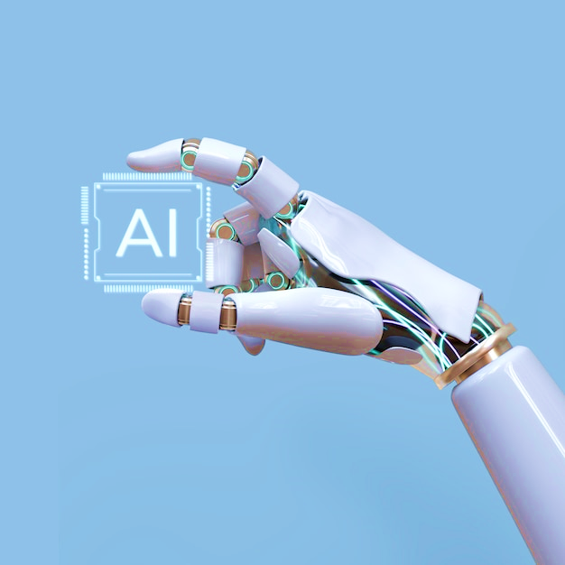
Welcome to the unveiling of AI-EHRMS
AI-EHRMS is an innovative solution poised to revolutionize the landscape of Human Resource Management through the integration of Artificial Intelligence (AI).
In today's dynamic business environment, organizations grapple with the challenge of optimizing HR processes to meet the evolving needs of the workforce.

Slide 6





Introduction to AI-EHRMS System cont.
HEADING 05
Based on the research questions, we propose hypotheses that form the basis for our study:H1: AI-enhanced talent acquisition will result in a more efficient and diverse hiring process.
H2: AI-driven performance management will positively impact employee engagement and productivity.
Hypotheses
HEADING 04
Showcase AI tools for HR workflows and optimize talent acquisition.
Objectives
HEADING 03
How can AI enhance talent acquisition and recruitment, and what is the impact of AI-driven performance management on employee productivity and engagement?
Research Questions
HEADING 02
Introduce AI-EHRMS as a holistic, AI-driven HR management solution.
Purpose of the Study
HEADING 01
The research problem addressed by AI-EHRMS is of paramount significance, focusing on the need for advanced tools to navigate the complexities of modern HR management.
Research Problem's Significance

Slide 7

Motivations
02
01
Adaptability to Technological Advances
01
02
Enhanced Decision-Making
03
03
Improved Talent Acquisition
HRM Motivation
04
Employee Engagement and Satisfaction
06
04
05
Strategic HR Management
05
06
Efficiency and Automation

Slide 8


related works
First Research Paper (2023)
Research on Artificial Intelligence in Human Resource Management: Trends and Prospects
Second Research Paper (2021)
Impact of Artificial Intelligence on Recruitment and Selection of Information Technology Companies
The analysis explores trends, themes, and future directions for research in AI-HRM.
It examines the impact of AI on recruitment and selection in Chennai's IT companies through literature review and survey research.
Research Paper
It enhances AI-HRM research with references, insights, and in-depth perspectives on emerging trends and knowledge in the field.
Its advantages encompass heightened efficiency and accuracy.
Benefits
Absence of a specific start date for the Scopus search in the literature, potentially leading to the exclusion of relevant studies.
A limitation of this study is the relatively small sample size.
Limitations

Slide 9
related works cont.
Third Research Paper (2022)
JOB MATCHING USING ARTIFICIAL INTELLIGENCE
Fourth Research Paper (2021)
(CVs) Evaluation Using Machine Learning Approach
It created an AI-based job matching algorithm incorporating previous hiring settings, currently used by the Department of Employment, Thailand.
It focuses on using Machine learning to assess CVs for higher education students, enhancing accuracy and effectiveness of candidate evaluations.
Research Paper
AI job matching: Enhancing candidate-employer matches and hiring processes.
It automates preselection and candidate assessment, delivering precise evaluation results and substituting manual processes.
Benefits
The challenge in acquiring an extensive dataset of personal information about individuals' work.
ML for CV evaluation requires a substantial volume of data for training and may have limitations beyond the training data.
Limitations

Slide 10
Comparison between existing works
Nom
Technology
Used
Functions
Functionalities
Objectives
Benefits
Limitations
Automates recruitment process
Resume review, personalized job recommendations
Faster job search, optimized recruitment process
More relevant job opportunities, personalized resume tools, enhanced user experience
Potential challenges in AI implementation, biases, lack of human touch
JobLeads
Website
AI, NLP, ML
More relevant job opportunities, AI-powered job description generation, enhanced accuracy and efficiency of HRM process
Potential challenges in AI implementation, biases, complex HRM processes
Matches job seekers with relevant jobs
Resume analysis, job description generation
Facilitates job search, enhances HRM process
AI, ML, NLP
Bayt.com Website
Company reviews, salary insights, interview experiences, job application tracking
Personalized job recommendations, tailored company reviews and interview insights, accurate salary information
Potential challenges in AI implementation, biases in personalized recommendations, limitations in fully automating complex HRM processes
Provides comprehensive job search platform
Glassdoor: Jobs
& Community App
Informed career decisions
AI, NLP, ML

Slide 11



Problem statement
Challenges Faced by HR Departments:
Geographical constraints, excessive paperwork,
and high advertising costs hinder traditional job recruitment processes.
access information about opportunities, limiting their chances of employment.
Job seekers struggle to
job matching, and CV evaluation due to format restrictions, data scarcity, and potential bias.
Limitations in modern systems
for resume recommendation
How AI Can Address HR Inefficiencies?
01
02
03
04
05
06
Resume screening
Candidate communication
Interview scheduling
Pre-screening
Sourcing candidates
Onboarding

Slide 12

System objectives (aims)
Benefits of integrating AI into HR systems
Key functions AI can serve in AI-EHRMS
Tools that may be added in the future
Evaluating AI impact on HRM outcomes
AI-powered Recruitment and Talent Acquisition
AI-enabled Performance Management and Evaluation
The Evolution of HRM: From Traditional to Cutting-Edge
AI-driven Employee Engagement and Retention Strategies
Resume Parsing and Candidate Screening
Applicant Tracking and Ranking
Chatbots for Candidate and Employee Queries
Employee Sentiment Analysis
Training and Development Programs
Performance Management
Workforce Analytics and Planning
Compliance Monitoring
Define Objectives
Identify Key Metrics

Slide 13





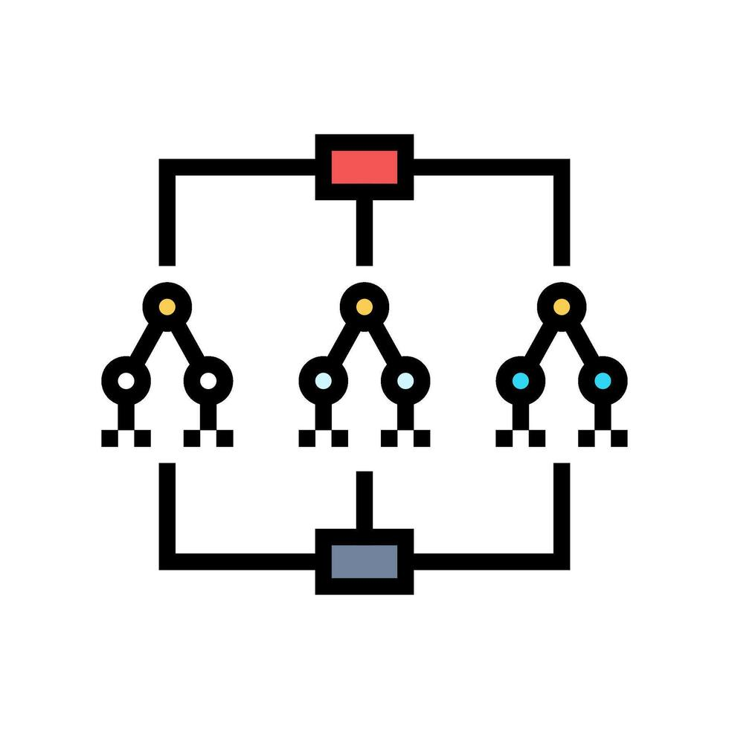
System tools and languages
Frontend
BackEnd
Machine Learning
HTML
CSS
JS
By React framework
Node.js
mySQL
npm
Python
Nltk
Flask
Neural Networks
Random Forest

Slide 14
System Analysis and design

Slide 15
System Analysis and Design
Job seeker Login
HR Topic Chatbot
General Requirements
HR Signup
Businessman sign up
Find Job
Online job search
Function Requirements
Job seeker Signup
Function Requirements
Add jobs by businessman
Function Requirements
Job recommendation
Businessman login
HR Login
calendar
Job matching
Search for a job seeker
Create CV

Slide 16
System Analysis and Design cont.
Compatibility
Fault Tolerance
Security
Maintainability
Non-Function Requirements
Availability
Non-Function Requirements
Auditability
Scalability
Compliance
Training & Support
Usability

Slide 17
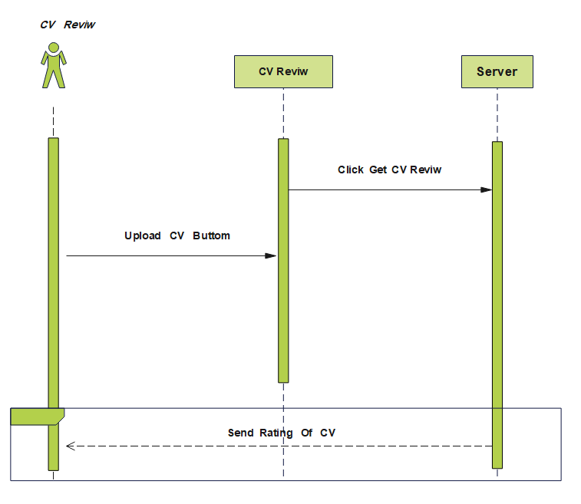
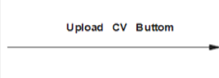

Sequence Diagram

Slide 18
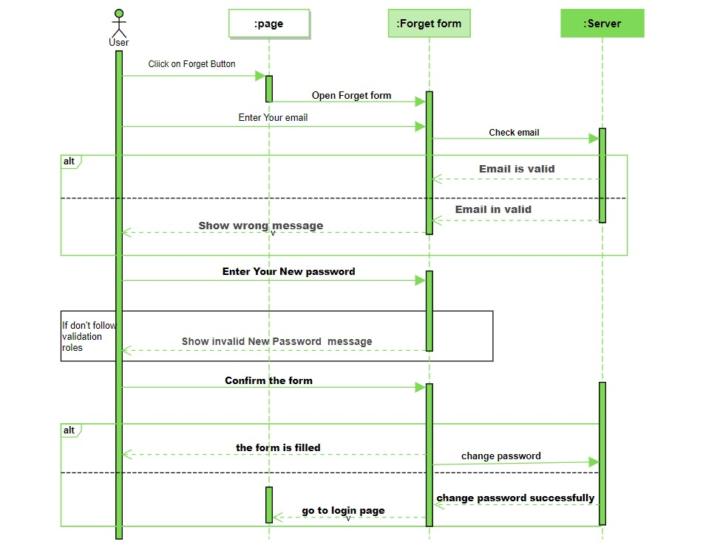
Click on forget button
Email is invalid
Sequence Diagram

Slide 19
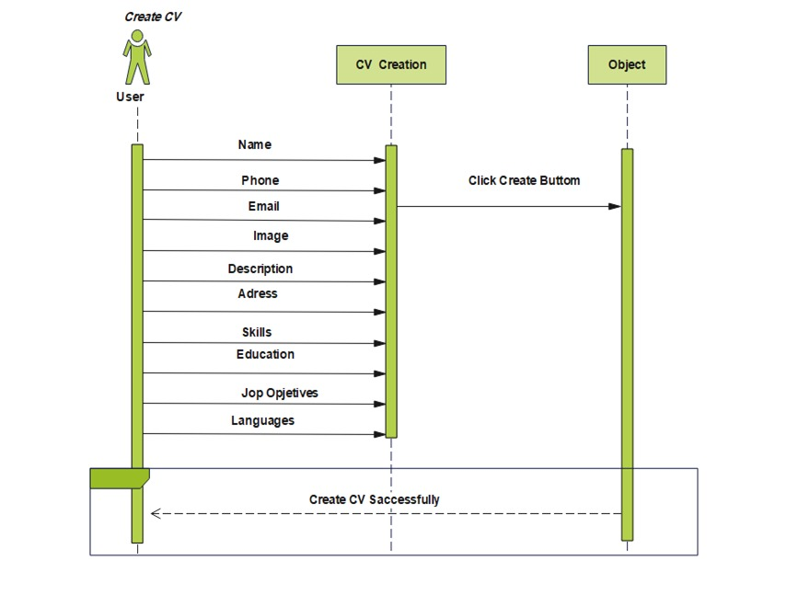
server
Server
Store data
Sequence Diagram
Address
Create CV Successfully

Slide 20
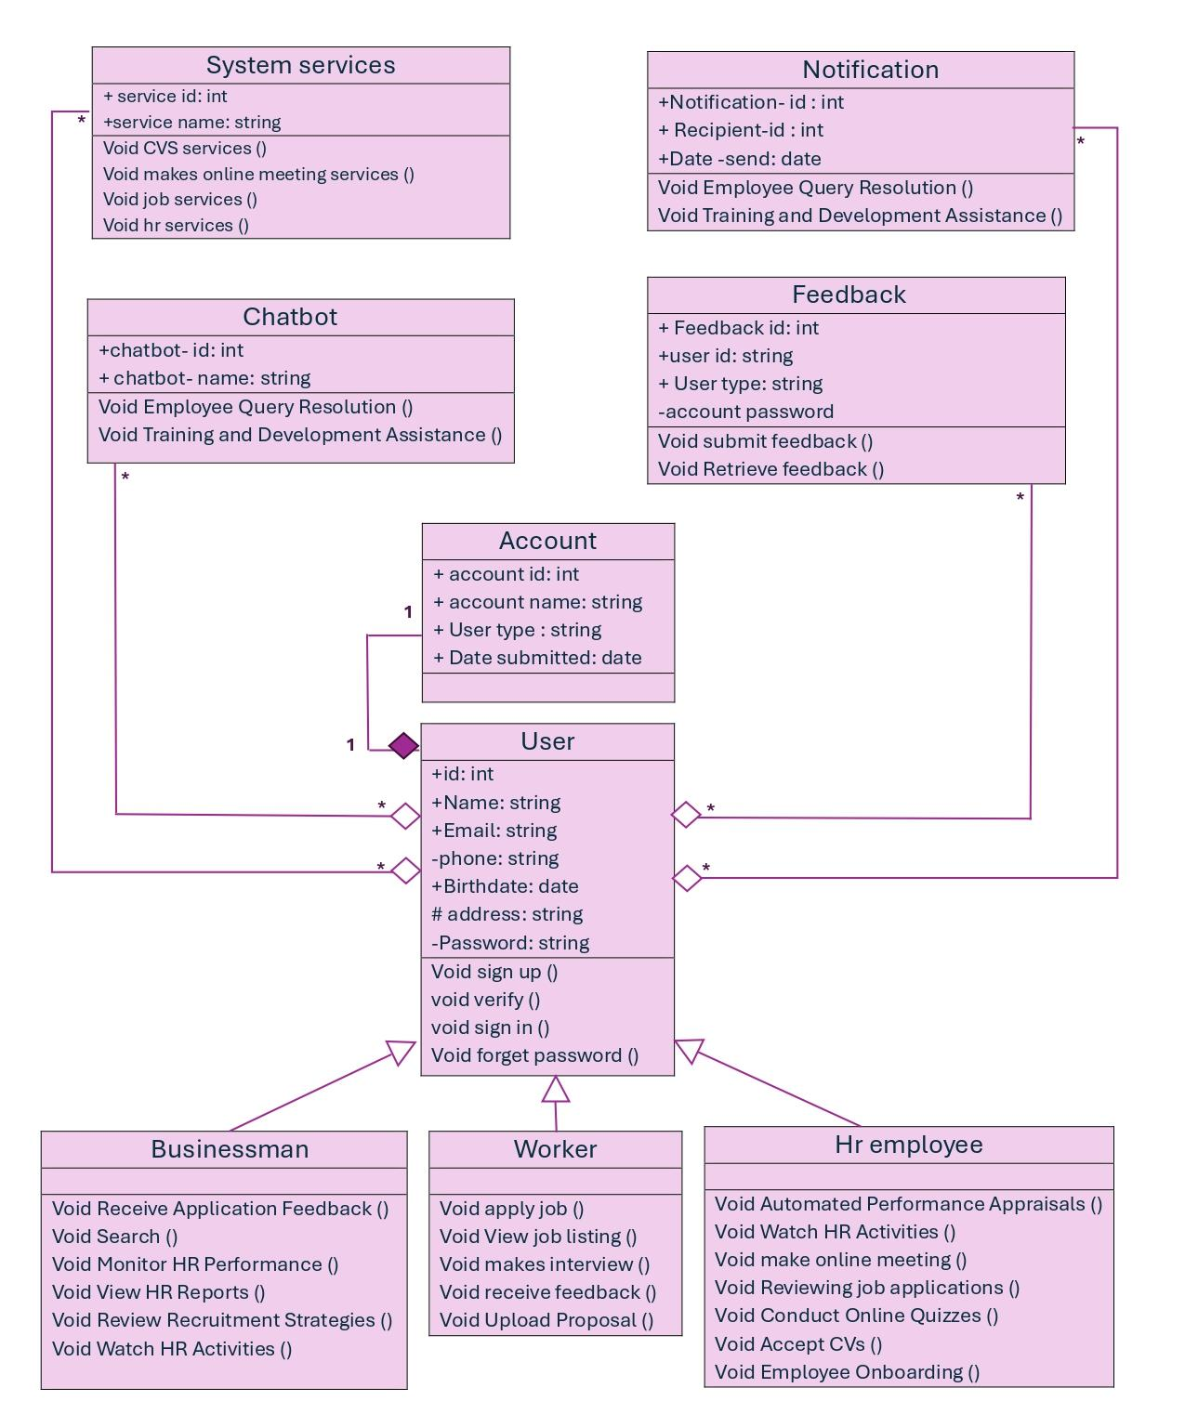
Class
Diagram

Slide 21
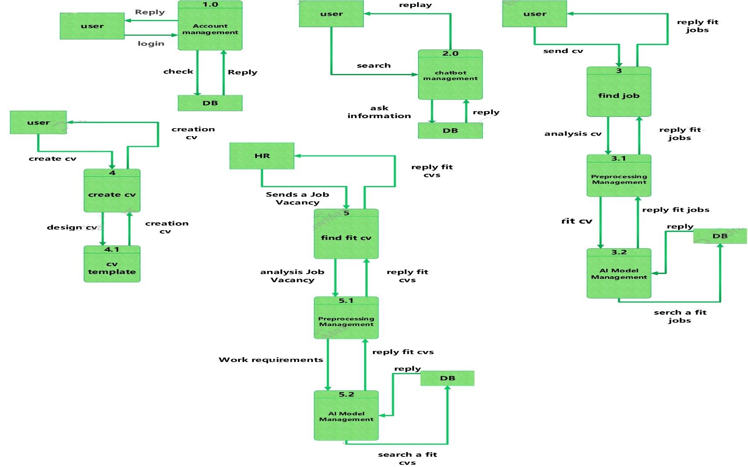
Data flow
Diagram

Slide 22
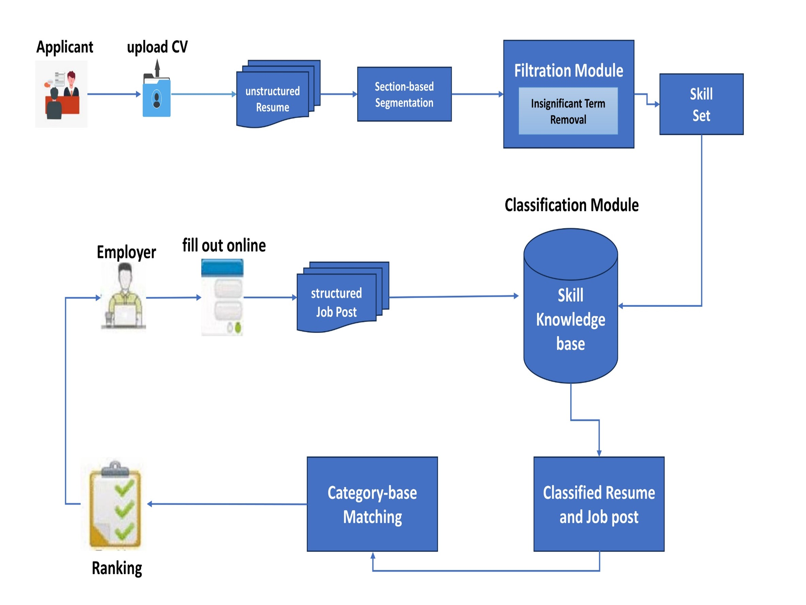
System Architecture

Slide 23
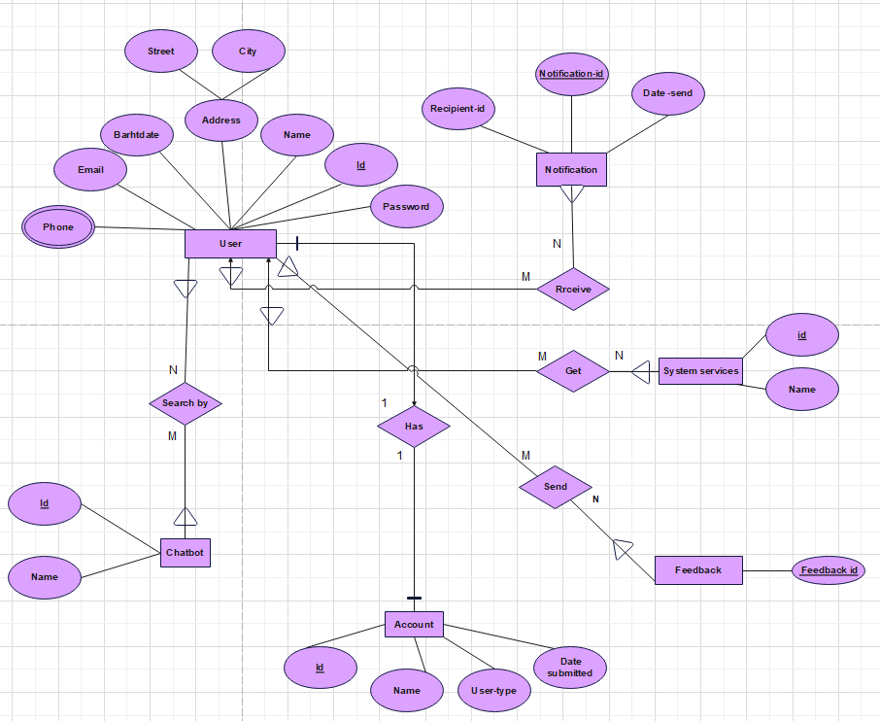
ERD
Diagram

Slide 24



HRBOTIX SITE MAP
Sign up as job seeker
Sign up as Businessmen
Sign up as HR
ChatBot
CV Matching
Add an employment request
Create CV
Search for job seeker
CV Review
Search for job seeker
Create CV
Scheduling

Slide 25
System implementation

Slide 26
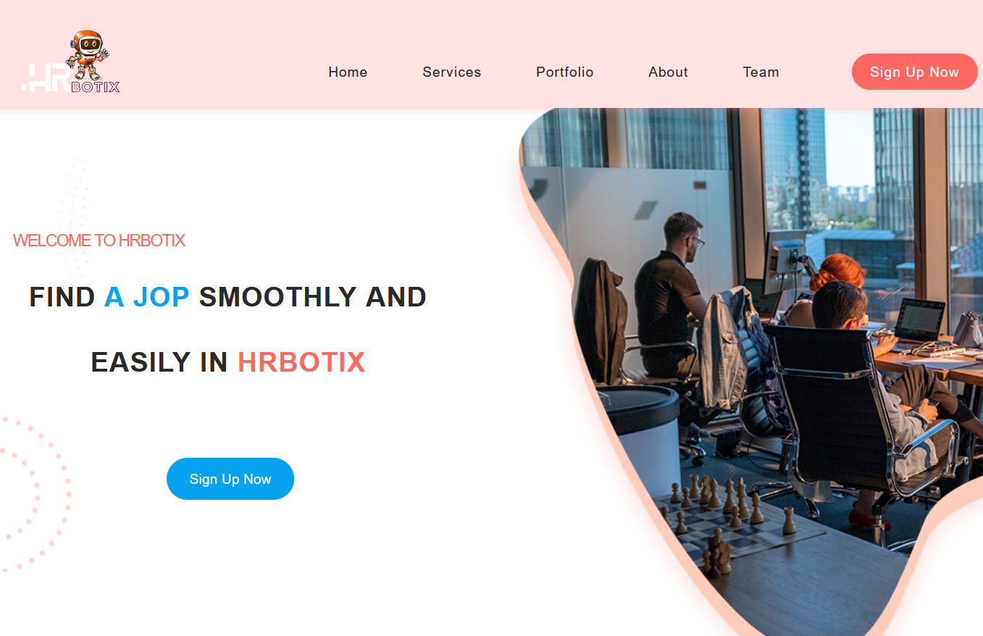
1
Main Page

Slide 27
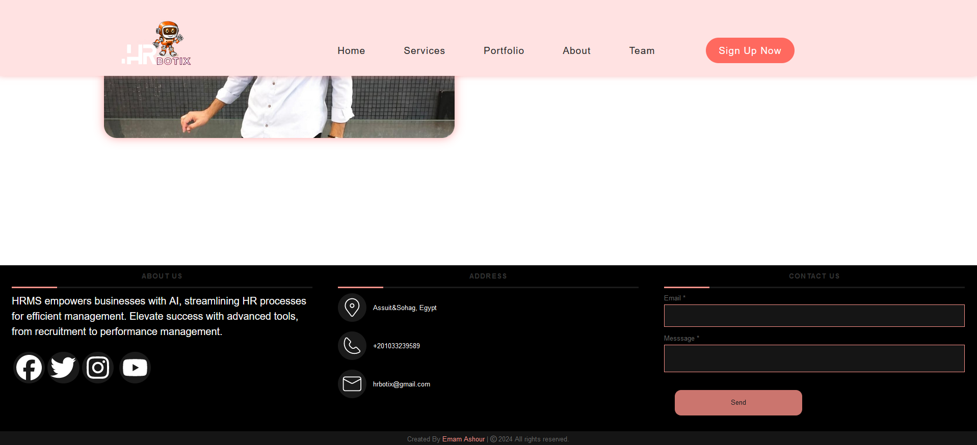
2
Footer

Slide 28
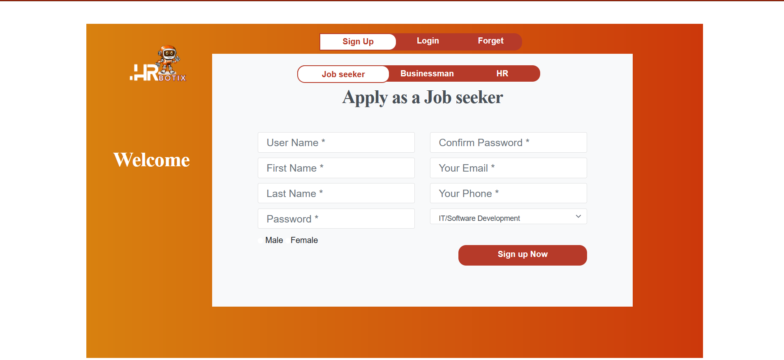
3
Sign up as job seeker

Slide 29
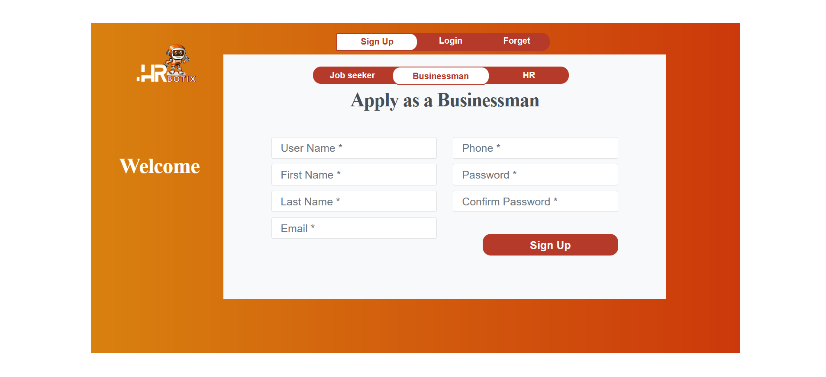
4
Sign up as businessman

Slide 30
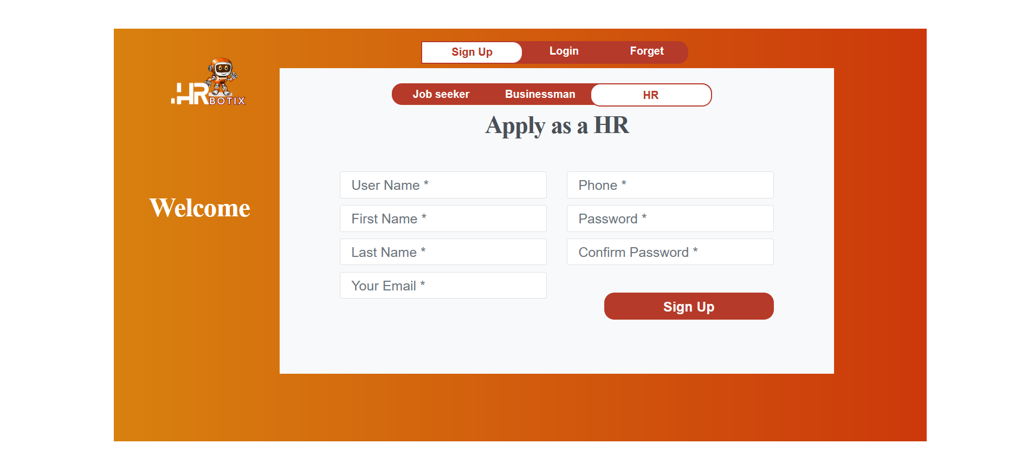
5
Sign up as HR

Slide 31
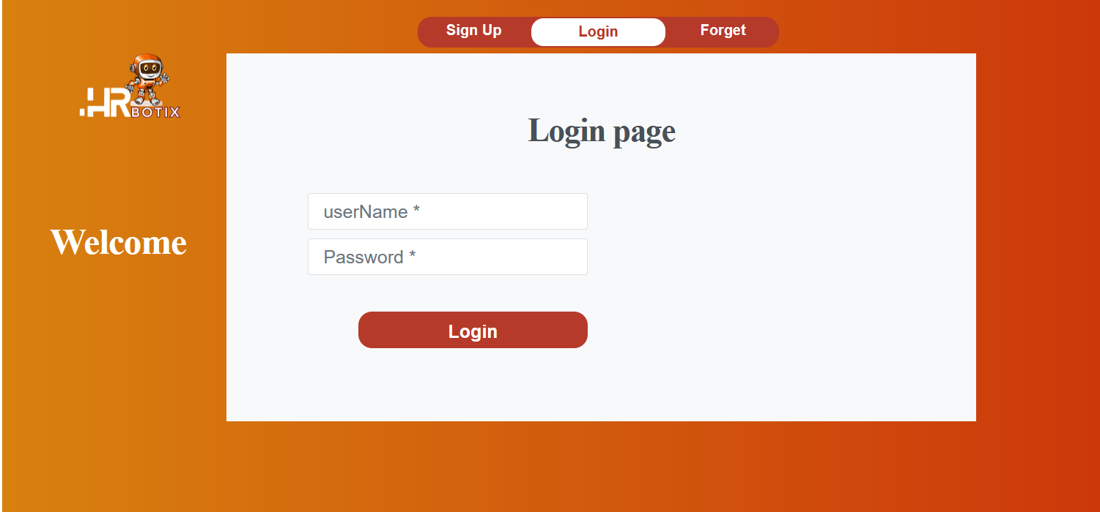
6
Login Page

Slide 32
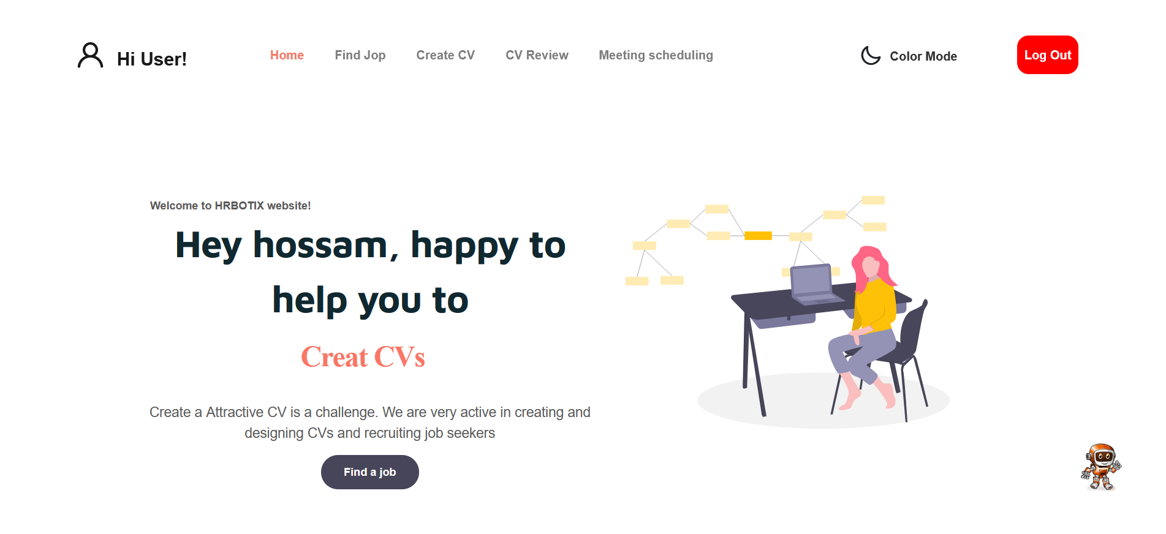
7
Home of job
seeker

Slide 33
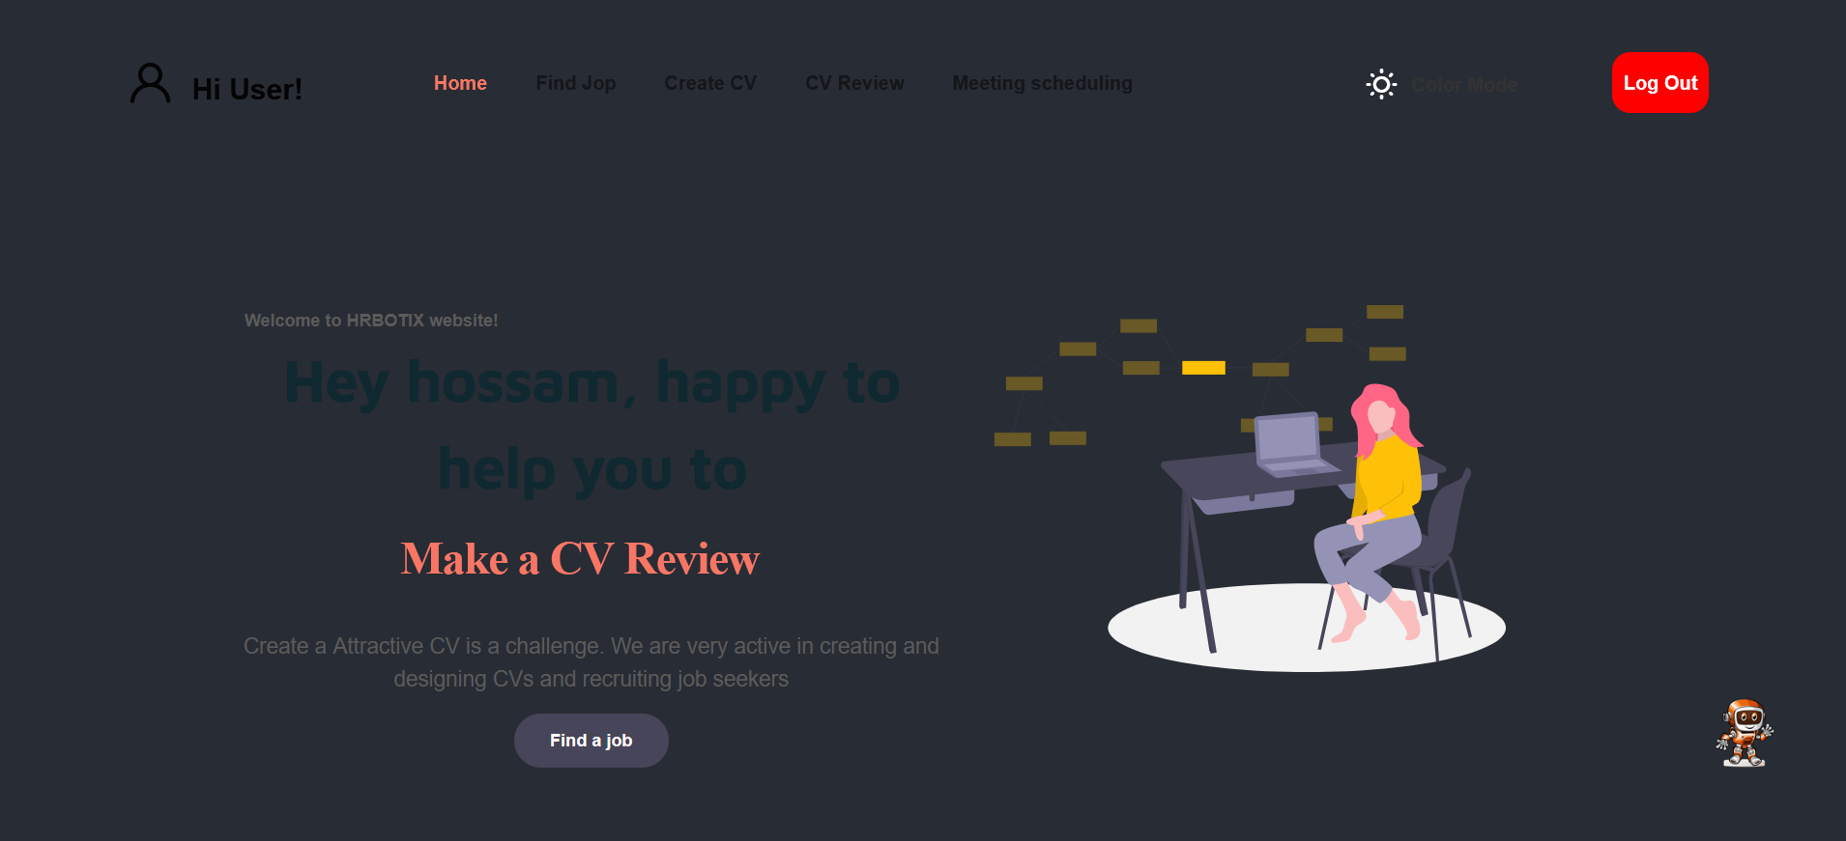
8
Dark Mode

Slide 34
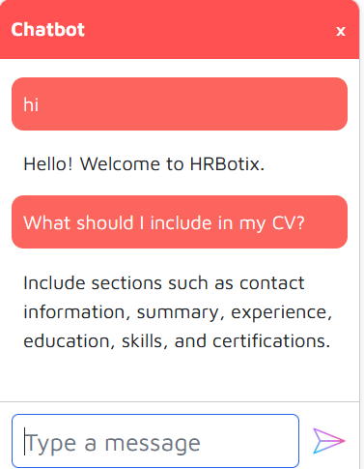
9
Chatbot

Slide 35
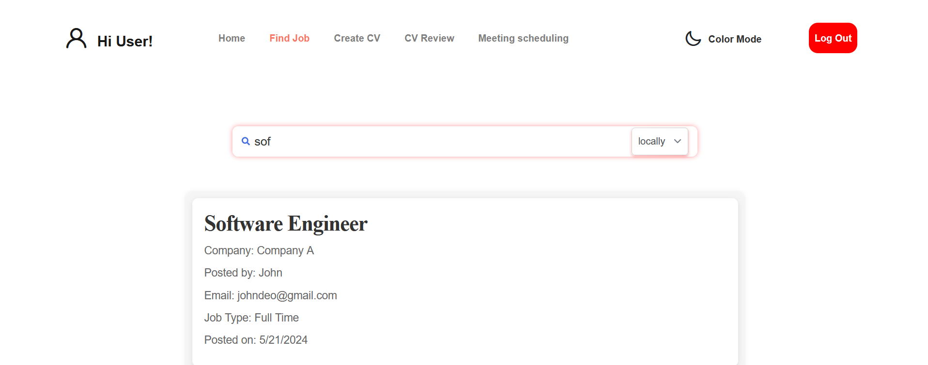
10
Find job locally

Slide 36
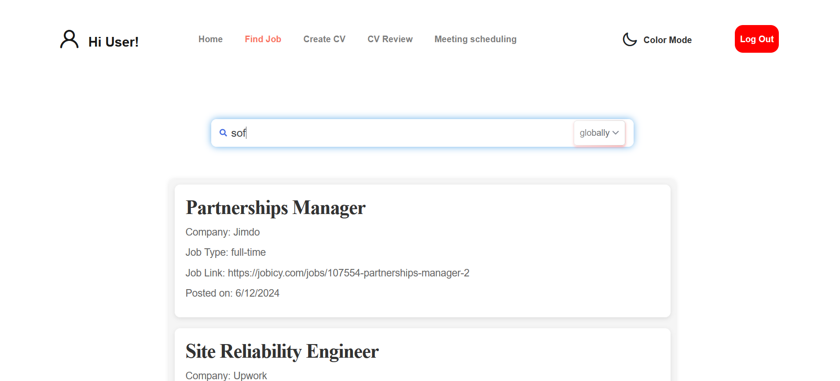
11
Find job
globally

Slide 37
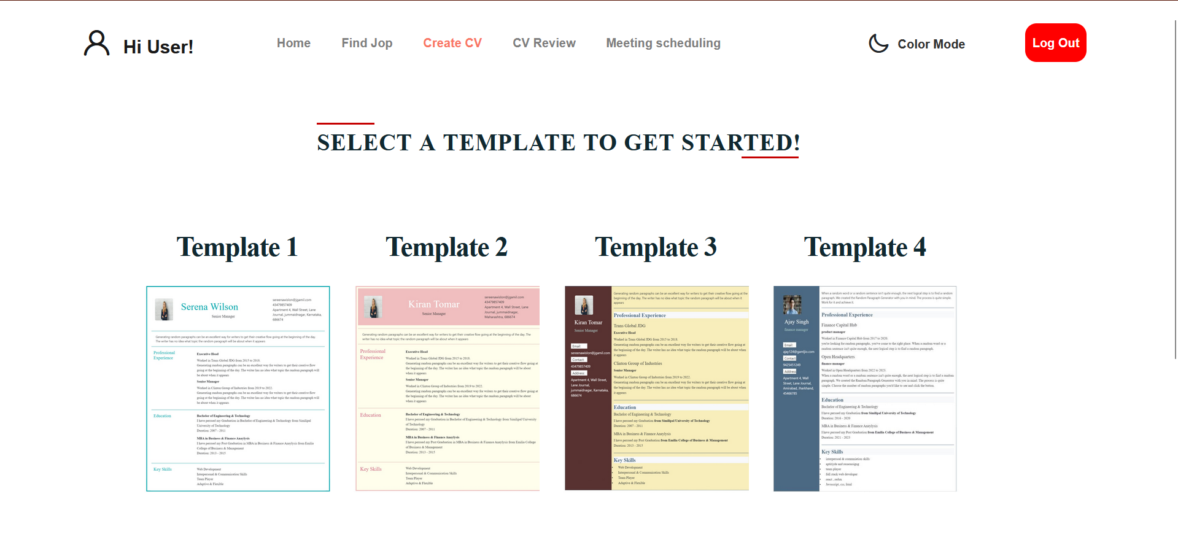
12
Create CV

Slide 38
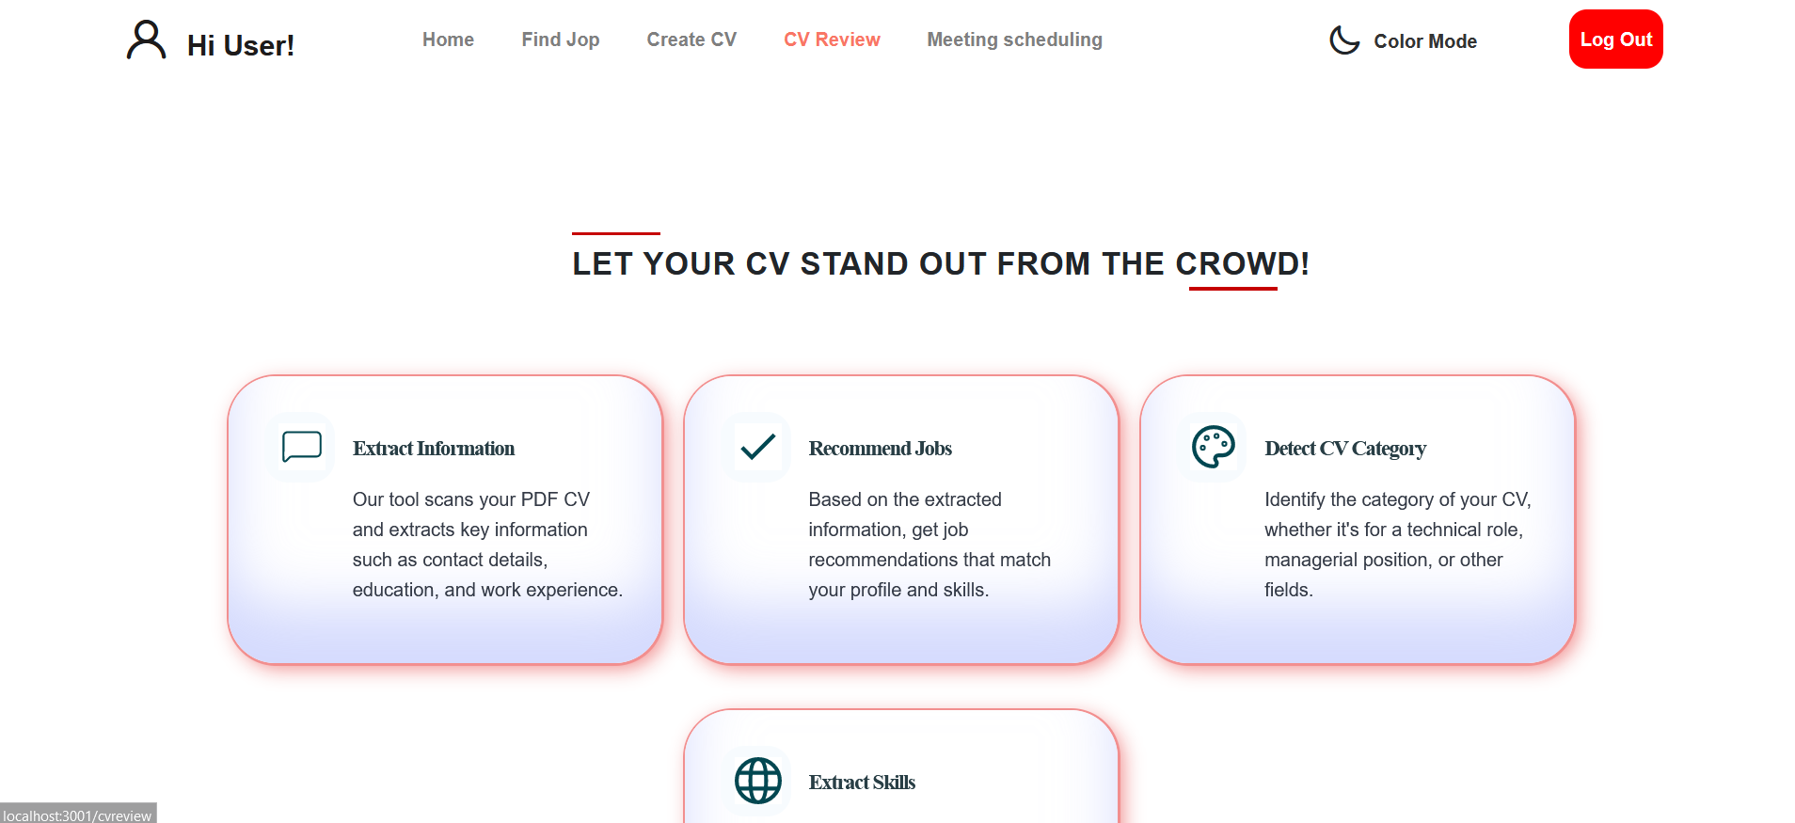
13
CV Review

Slide 39
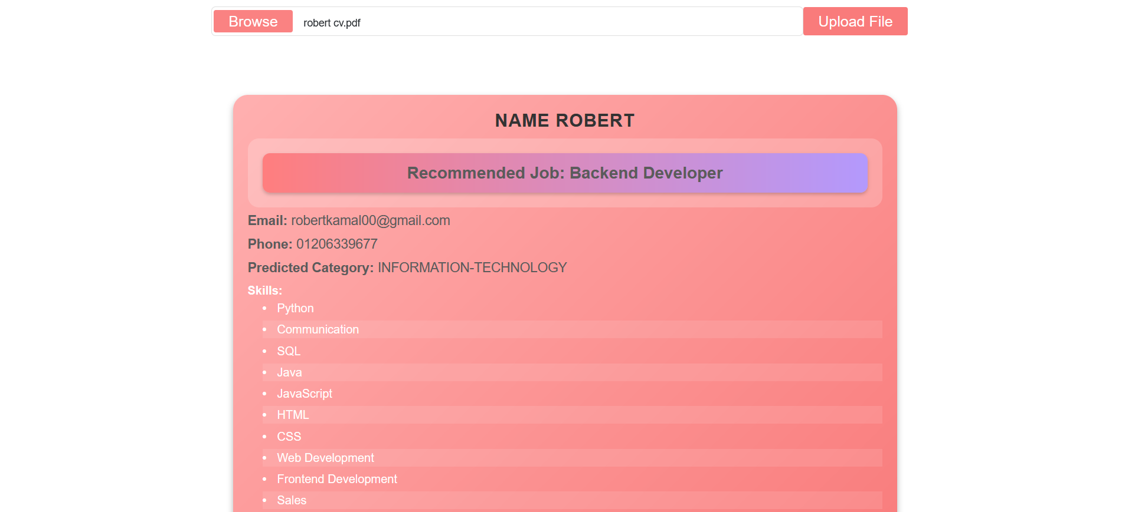
14
CV review results
by job seeker

Slide 40
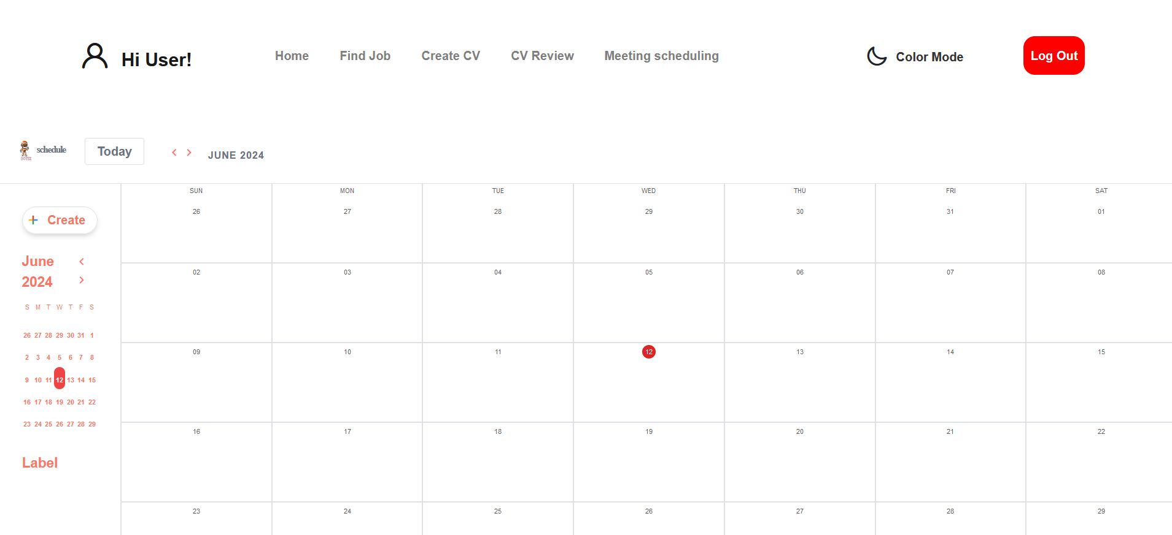
15
Schedule

Slide 41
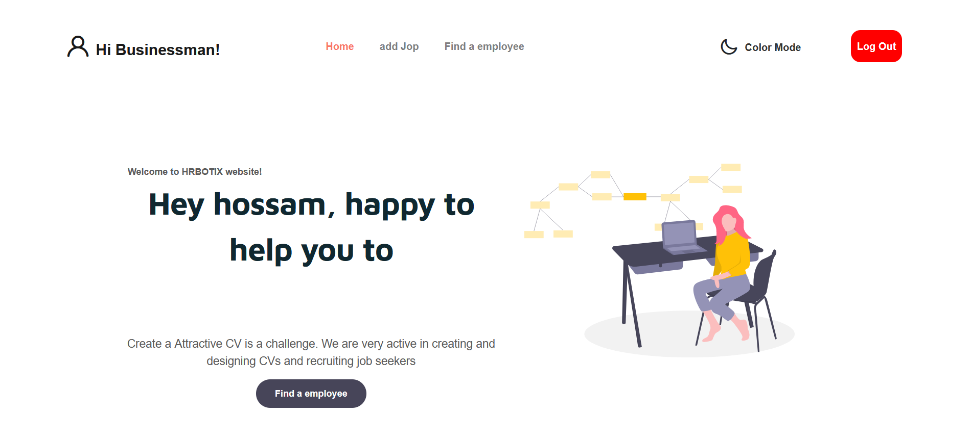
16
Home of businessman

Slide 42
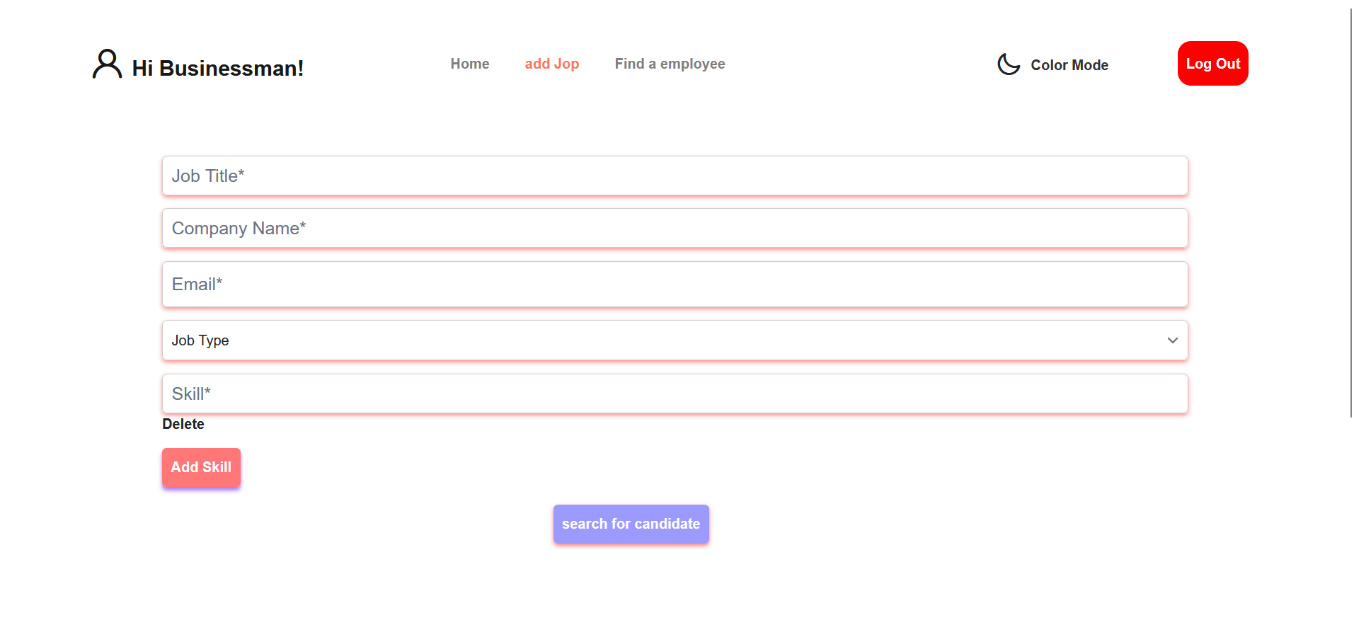
17
Add Job

Slide 43
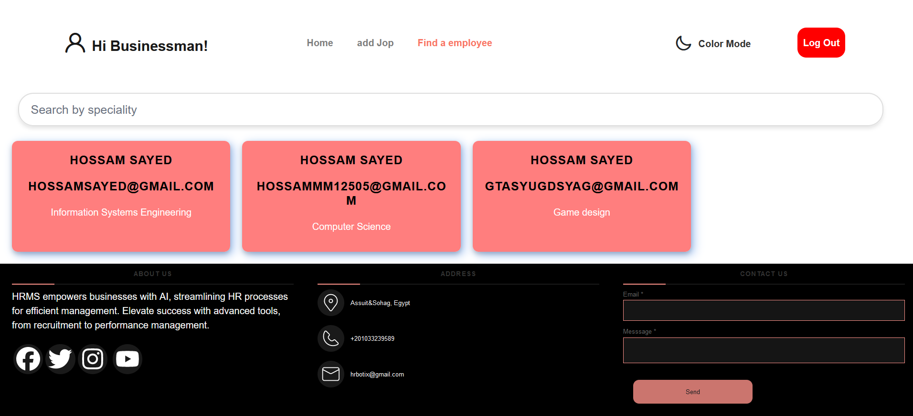
18
Find an employee

Slide 44
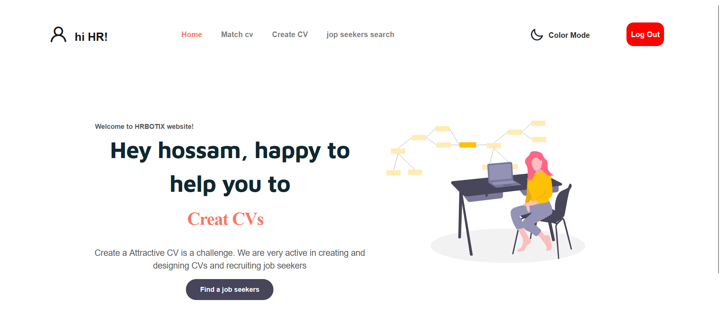
19
Home of HR (Admin)

Slide 45
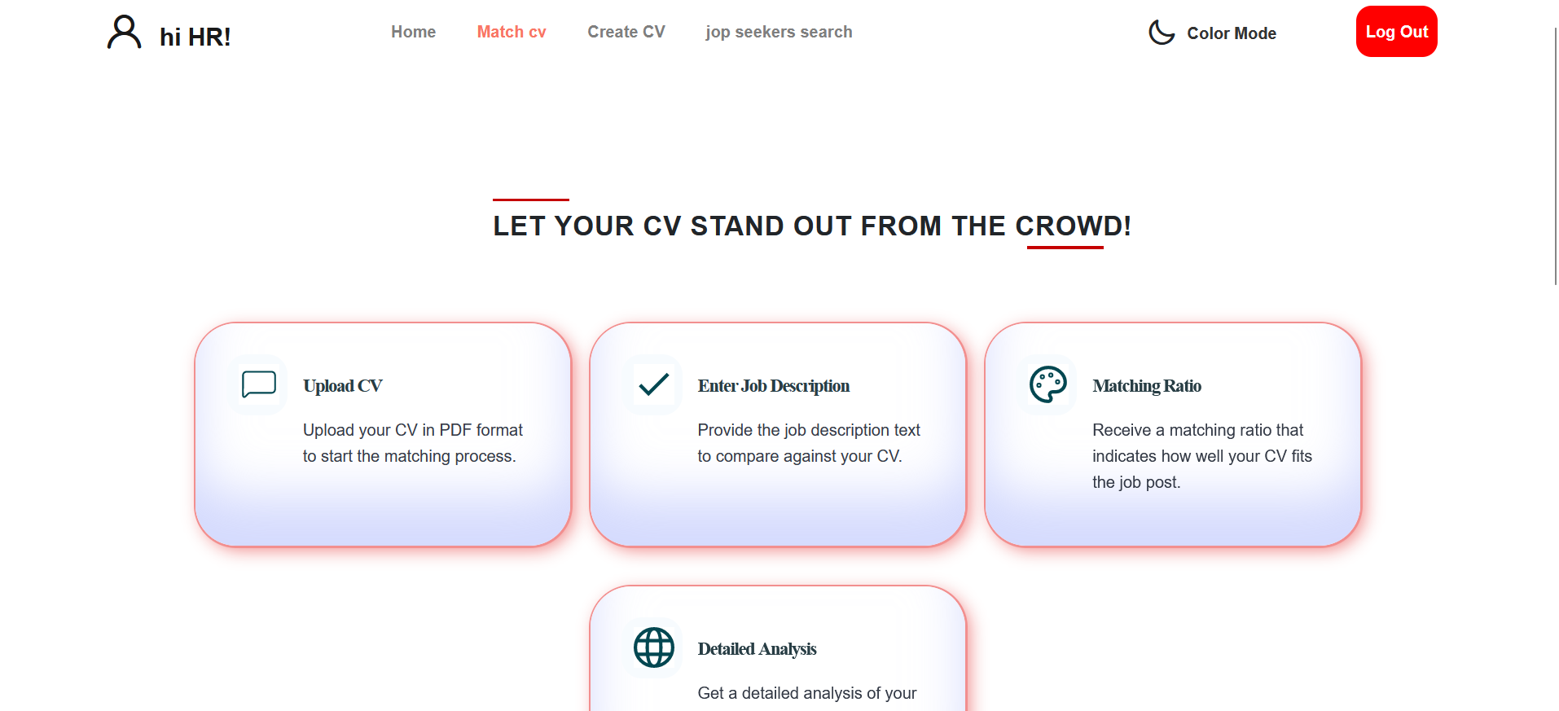
20
Match CV

Slide 46
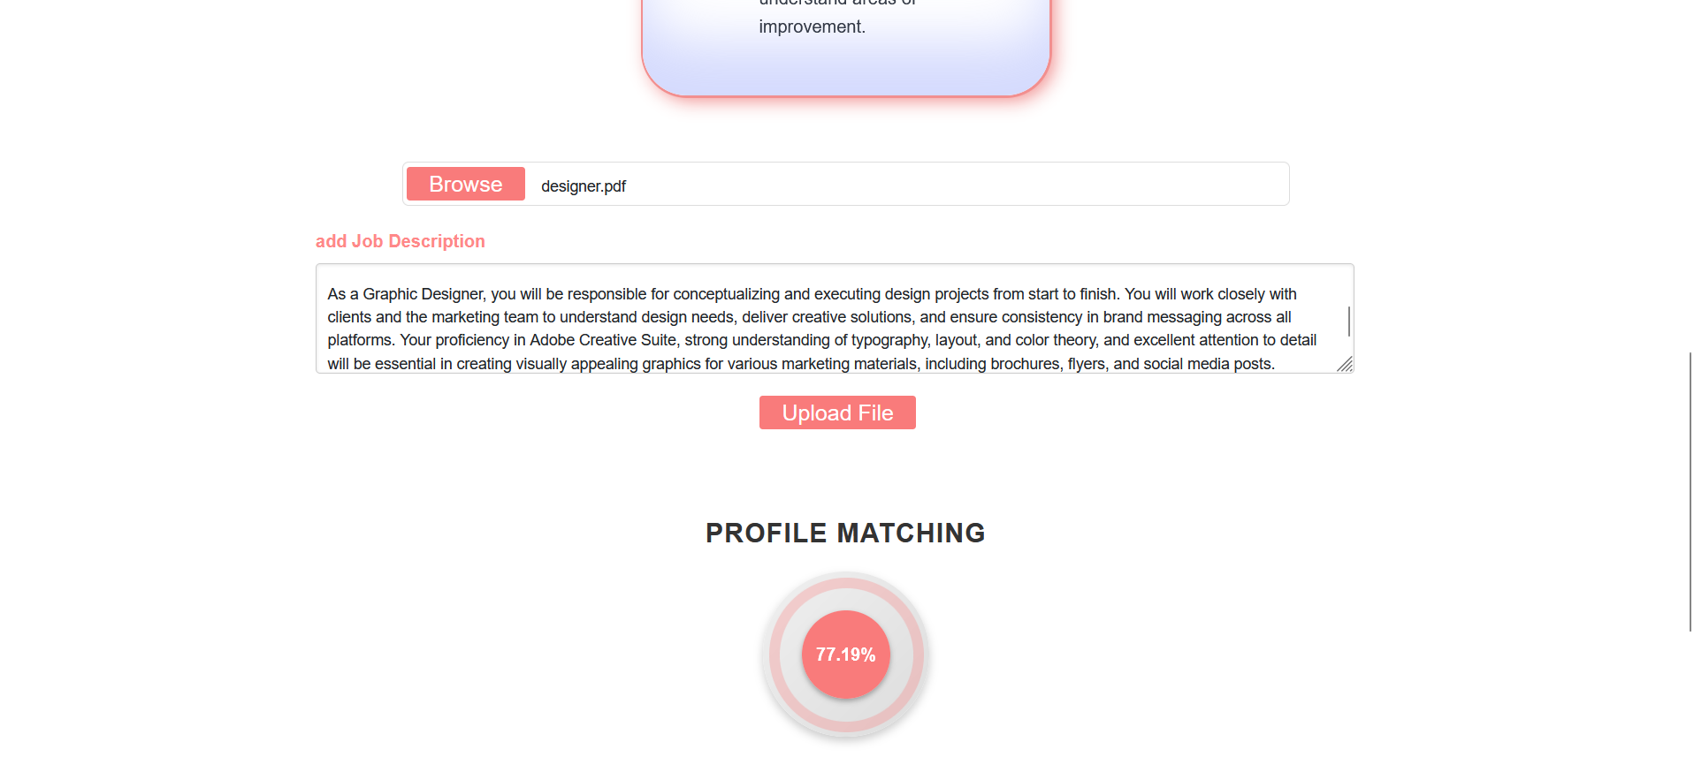
21
Match CV cont.

Slide 47
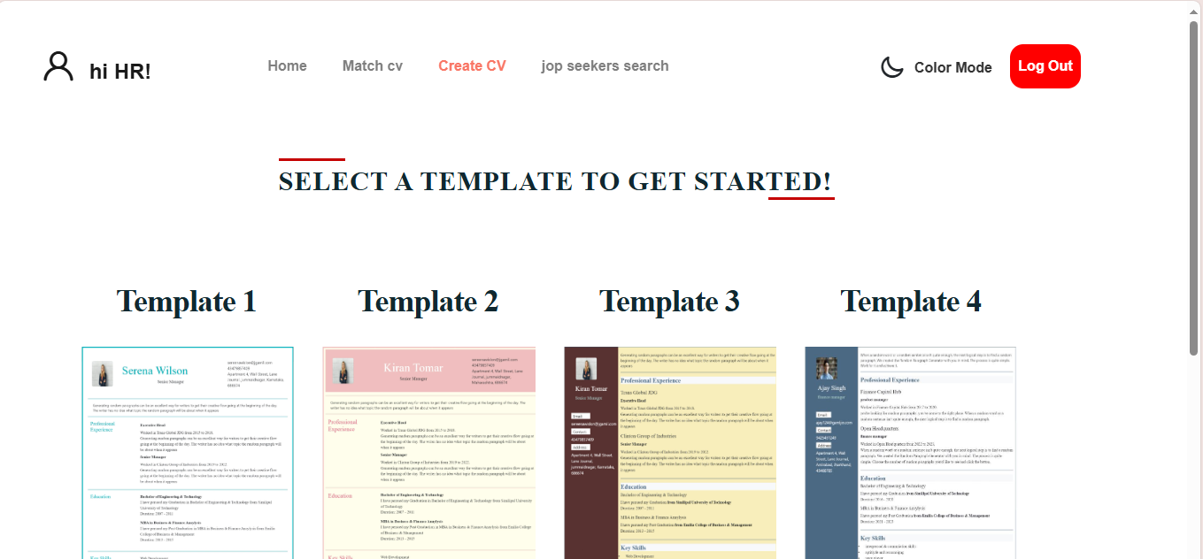
22
Create CV (HR)

Slide 48
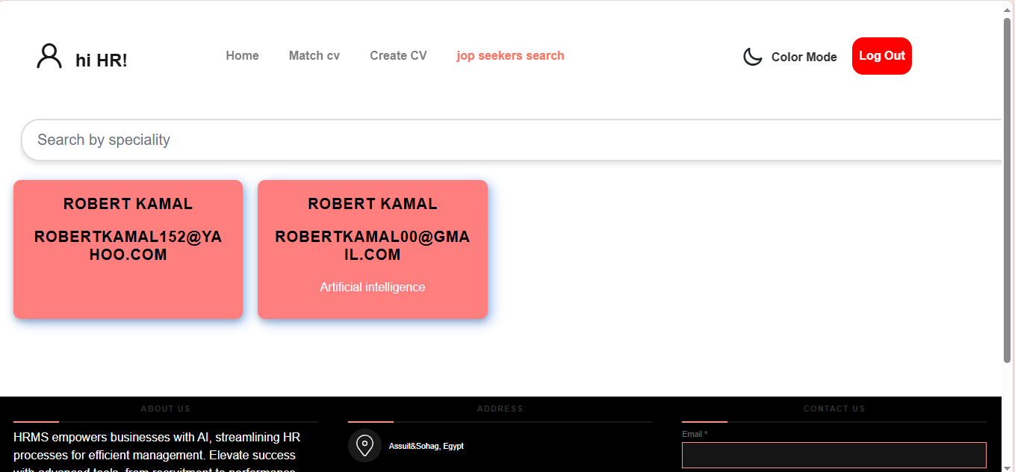
23
Find an employee for HR (Admin)

Slide 49
System Demo

Slide 50
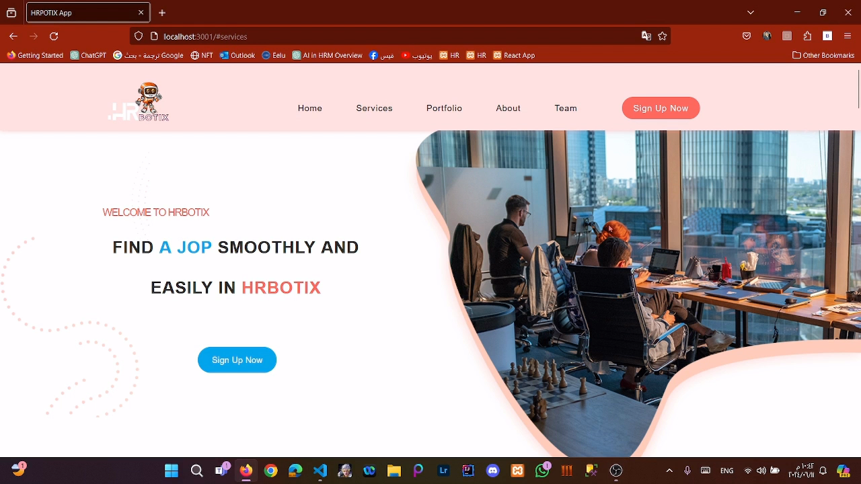

Slide 51
System Testing

Slide 52
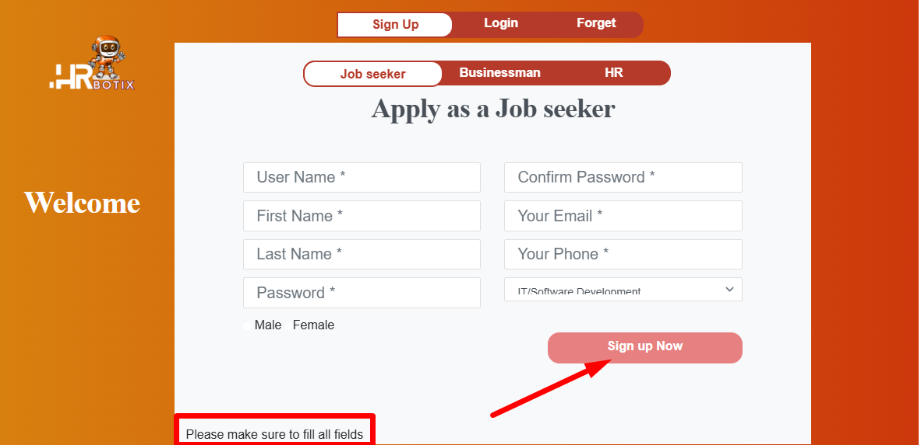
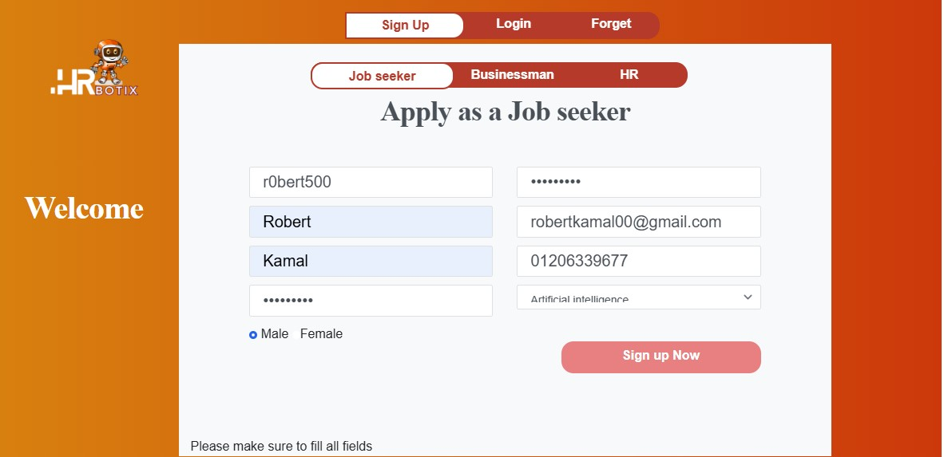
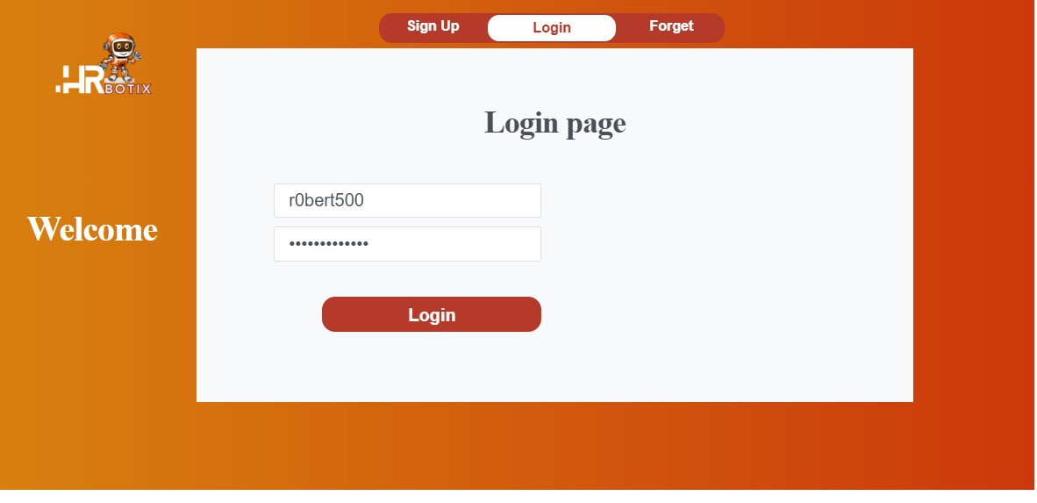
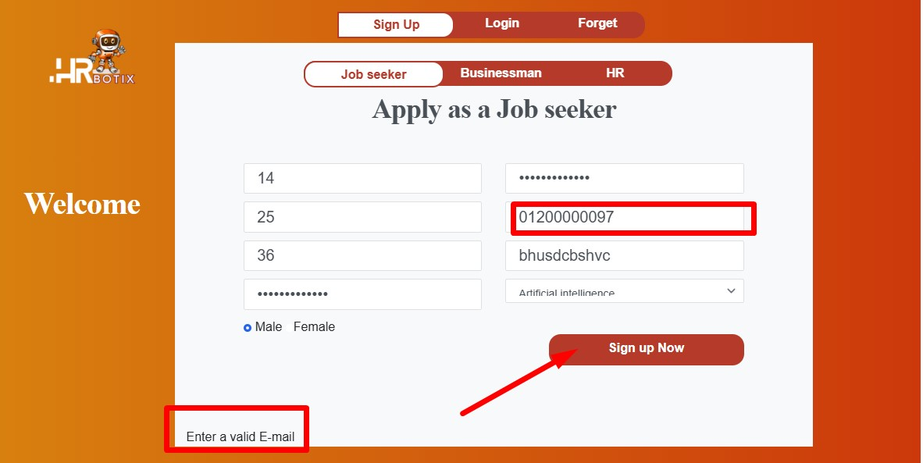






System Testing
Sign Up
Sign Up | Input test data | Output test data
 | Empty | “Data is required ” message
 | The correct information in all of the fields | Sign up will be successful and redirect to login page
 | Incorrect information in any of the fields | An error message appears indicating that the data is incorrect and requests to enter the correct data.

Slide 53
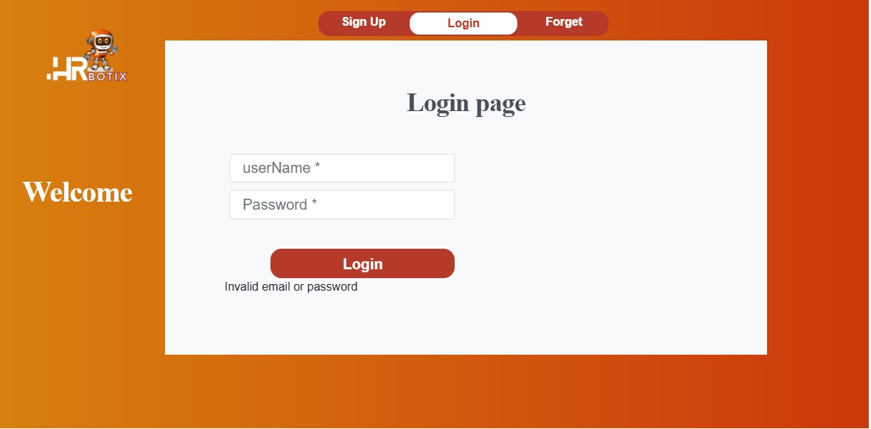
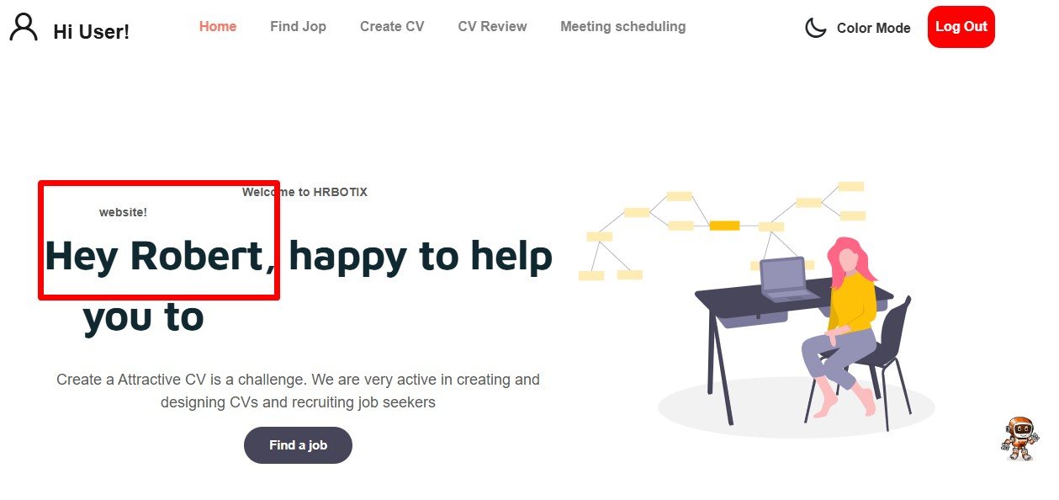
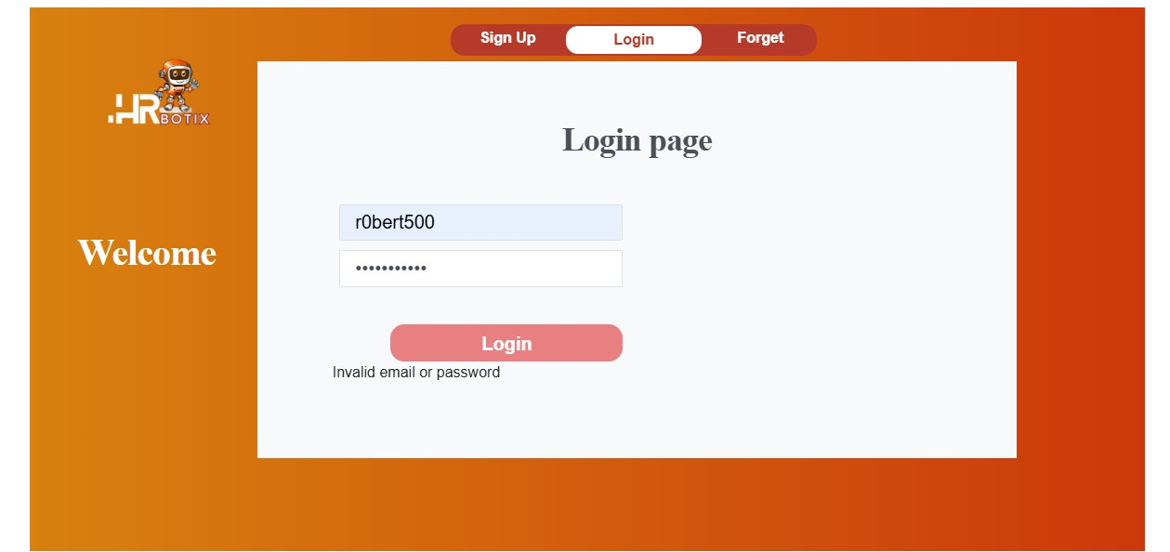
System Testing cont.
Sign In by Job seeker
Sign Up | Input test data | Output test data
 | Empty | “Please provide email and password” Message
 | The correct information in all of the fields | Sign In will be successful and redirect to his/her profile
 | Incorrect information in any of the fields | An error message appears indicating that the data is incorrect and requests to enter the correct data.

Slide 54
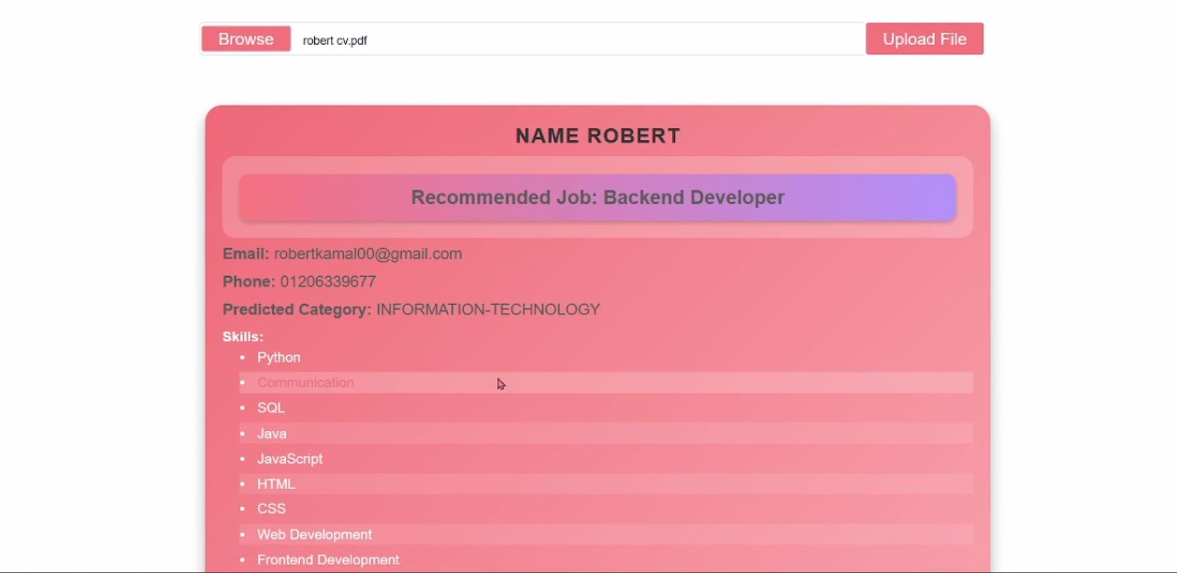
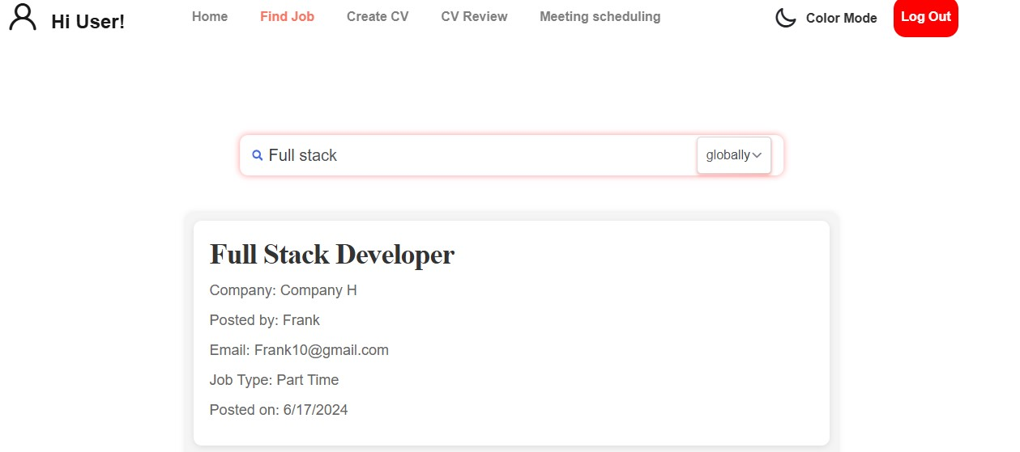




System Testing cont.
CV Review
CV Review | Input test data | Output test data
 | Click browse then select the CV file to review and click upload to see the result. | Redirect to the Viewing area on the screen to show the review results.
Find Job
Find Job | Input test data | Output test data
 | Enter query or search term to find your job | Redirect to the Viewing area on the screen to show the selected job from search.

Slide 55
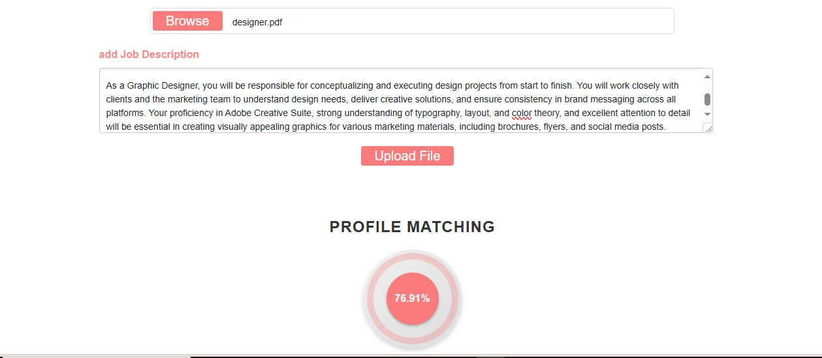
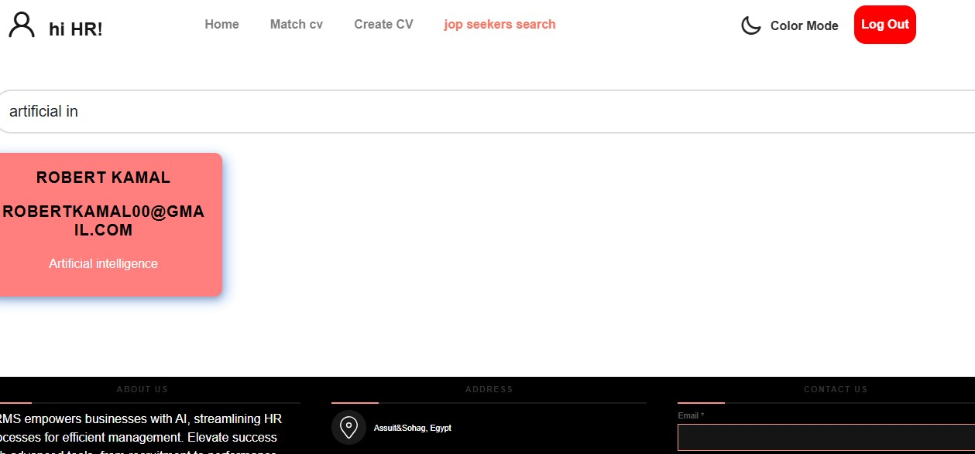
System Testing cont.
Job Matching (HR)
Job Matching by HR Admin | Input test data | Output test data
 | Click browse and select the CV file to match and add job description then click upload to see the result. | Redirect to the Viewing area on the screen which displays the matching percentage between the CV and the job description.
Find Job seeker (BM)
Find Job seeker (Admin) | Input test data | Output test data
 | Enter query or search term to find an employee | Redirect to the Viewing area on the screen to show the selected employee for your job.

Slide 56
Future work

Slide 57






Future Work:
Applicant Tracking and Ranking
Training and Development Programs
Performance Management
Employee Sentiment Analysis
Workforce Analytics and Planning

Slide 58
Conclusion

Slide 59
In conclusion, the HRBotix project represents a groundbreaking leap forward in the realm of HRM. By integrating cutting-edge technologies like AI, NLP, and ML, HRBotix has redefined the landscape of HR processes.
Through a meticulous literature review, detailed system analysis, and robust system design, HRBotix has not only identified key challenges in traditional HR systems but has also provided innovative solutions to address them.
With a focus on enhancing candidate screening, resume parsing, and employee sentiment analysis, HRBotix empowers HR professionals to make data-driven decisions efficiently and effectively.
As we embark on the next phase of this project, we are excited to see the impact HRBotix will have on revolutionizing HR practices and shaping the future of Human Resource Management.

Slide 60
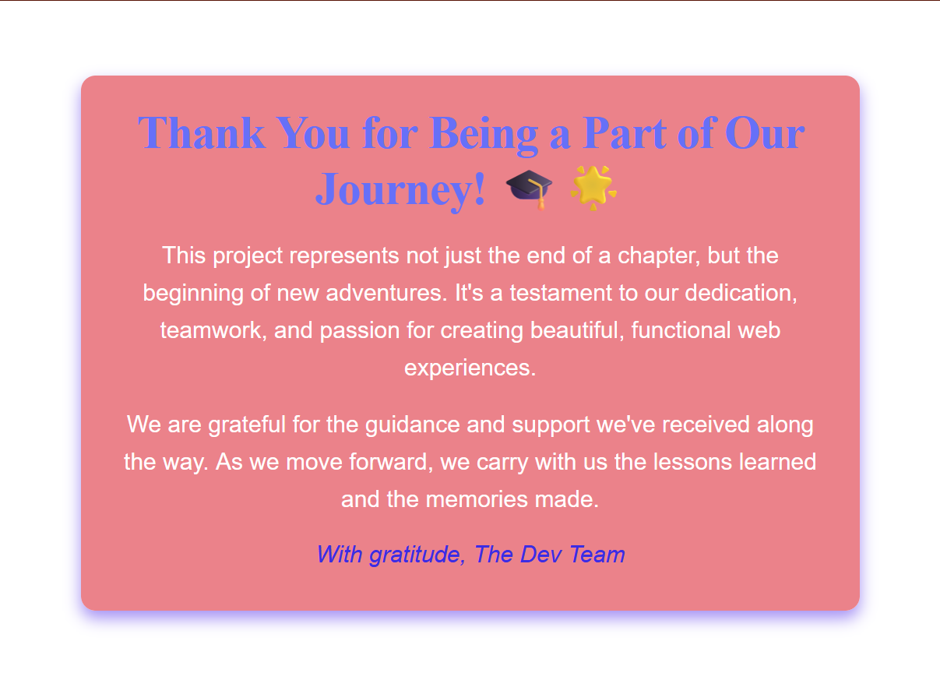
Thanks

Slide 61


Any Questions….. ?
Thank You
For Your Attention

Slide 62



